Slide 1
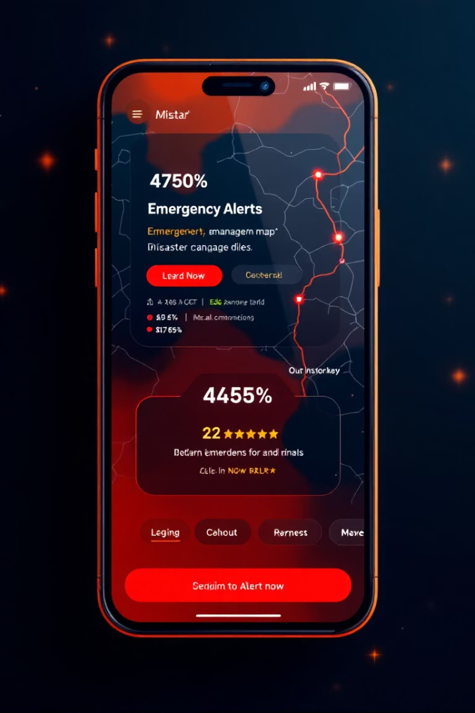
Mobile App Disaster Management
Welcome to our comprehensive report on Mobile App Disaster Management. This presentation outlines our analysis of requirements, prioritization strategies, and classification of features for an effective disaster management application.
Prepared by Eban Boris Manyo, Nyenty Obi Ramson, Ikome Bryan Johnson Monde, and Akawung Gabriel, this report provides insights into the technical feasibility, dependency relationships, and implementation considerations for a robust emergency response system.
AJ

Slide 2





Requirement Analysis Overview
Completeness Assessment
Evaluation of core features including user registration, emergency alerts, SOS signals, real-time mapping, and community help functionality.
Clarity Examination
Identification of clear vs. unclear requirements with specific examples to guide development priorities.
Technical Feasibility
Assessment of implementable features vs. technically challenging components requiring special attention.
Dependency Mapping
Recognition of interconnected features to prevent implementation conflicts and ensure logical development sequence.

Slide 3








Core Expected Features
Emergency Alerts
Broadcast notifications from authorities
SOS & GPS Tracking
Location-based distress signals
Real-time Disaster Mapping
Visual representation of affected areas
User Registration & Authentication
Secure account management
The foundation of an effective disaster management application relies on these essential features. Additional capabilities include emergency contacts and shelter information, disaster preparedness tips, push notifications with SMS alerts, community help coordination, and multilingual support to ensure accessibility across diverse populations.

Slide 4
Clarity in Requirements
Clear Requirements
Unclear Requirements
"The system shall allow users to register using email or phone number."
"Send emergency information" - Lacks specificity about who sends it, what information is included, and who receives it.
"Admin can send broadcast alerts to all users within a selected region."
"Show disaster map" - Doesn't specify data sources or map type (static vs. live).
These specifications clearly identify the actor, action, and outcome, providing developers with precise implementation guidance.
Vague verbs like "show," "send," and "manage" require clarification to ensure proper implementation.

Slide 5

Technical Feasibility Assessment
Feasible Features
Challenging Features
Push notifications via Firebase
Offline alerting system requiring local caching
GPS-based location services
REST API for alert management
Real-time maps with GIS integration
These features can be readily implemented using standard mobile development frameworks and SDKs.
Multilingual disaster messaging
These require specialized knowledge and additional development resources.
Implementation Considerations
Platform-specific capabilities
API integration complexity
Performance under emergency conditions
Careful planning needed to ensure reliable operation during disasters.

Slide 6
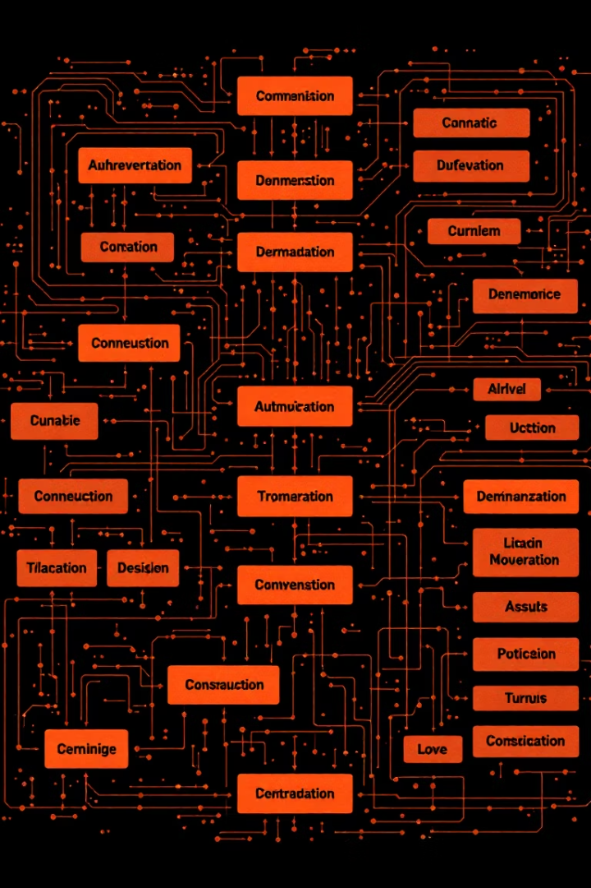




Dependency Relationships
User Registration
Required before personal SOS alerts can be sent or received
Location Access
Necessary for both alert targeting and map feature functionality
Admin Panel
Must exist before alerts can be created or broadcast to users
Data Storage
Required for user profiles, disaster history, and emergency information
Understanding these relationships is crucial to avoid implementation conflicts and ensure a logical development sequence. Features must be planned with their dependencies in mind to create a cohesive application architecture.

Slide 7

Identified Issues and Gaps
Issue Type
Example / Description
Ambiguity
"Users receive alerts" — What kind of alerts? How are they prioritized?
"
Inconsistency
Requirement says users can edit profile, but no mention of where that data is stored
Inconsistency
Requirement says app will send SMS alerts, but no SMS gateway is mentioned
Missing Info
No mention of how the app handles no internet connectivity during disaster

Slide 8




Requirement Prioritization
Must Have
Emergency alerts, location tracking, contact emergency services
Should Have
Disaster preparation tips, real-time map
Could Have
Chat with volunteers, donation features
Won't Have (for now)
AI prediction features
Using the MoSCoW method allows us to strategically allocate development resources to ensure the most critical disaster management features are implemented first. This approach balances immediate emergency response needs with enhanced functionality for future iterations.

Slide 9








Functional Requirements
User Management
Alert System
Registration, login, profile management using email or phone
Location-based notifications and disaster reporting with media
Information Resources
Community helep
Maps, emergency contacts, safety tips, and disaster history
Its base on help support from community people base on the area
The functional requirements define the specific behaviors and capabilities the system must provide. Additional features include a first responder interface with verified incident directions and a community help system allowing users to request and offer assistance during emergencies.

Slide 10

Non-Functional Requirements
10,000+
Performance
Must support concurrent users with minimal latency
99.5%
Availability
Uptime with cloud hosting and backup support
100%
Security
Data encryption and user authentication required
5+
Scalability
Regions and disaster types supported
Non-functional requirements define the quality attributes and operational constraints of the system. In addition to the metrics above, the application must provide an intuitive user interface with accessibility support to ensure usability across diverse populations, including those with disabilities.

